Slide 1

Chapter 5: Inter-VLAN Routing
Routing And Switching
Notes:
Cisco Networking Academy program
Routing & Switching
Chapter 5: : Inter-VLAN Routing

Slide 2
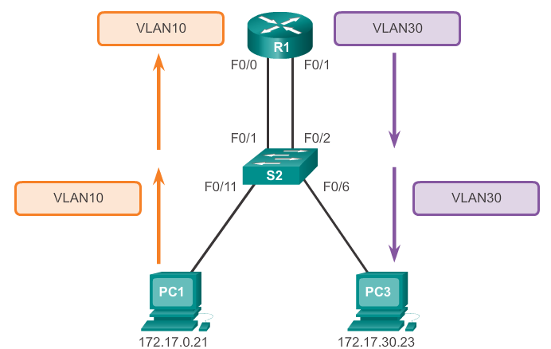
Inter-VLAN Routing Operation What is Inter-VLAN Routing?
Layer 2 switches can’t forward traffic between VLANs without the assistance of a router (Layer 3 device)
Inter-VLAN routing is a process for forwarding network traffic from one VLAN to another using a router
Notes:
5.1 Inter-VLAN Routing Configuration
5.1.1 Inter-VLAN Routing Operation
5.1.1.1 What is Inter-VLAN Routing?

Slide 3
Inter-VLAN Routing Operation Legacy (Traditional ) Inter-VLAN Routing
In the past, actual routers were used to route between VLAN
Each VLAN was connected to a different physical router interface (i.e. Fa0/0 or Fa0/1 etc.)
Packets would arrive on the router through one through interface, be routed and leave through another
Since the router interfaces were connected to VLANs and had IP addresses from that specific VLAN, routing between VLANs was achieved.
Simple solution but not scalable. Large networks with large number of VLANs would require lots of router interfaces.(expensive)
Notes:
5.1 Inter-VLAN Routing Configuration
5.1.1 Inter-VLAN Routing Operation
5.1.1.2 Legacy Inter-VLAN Routing

Slide 4
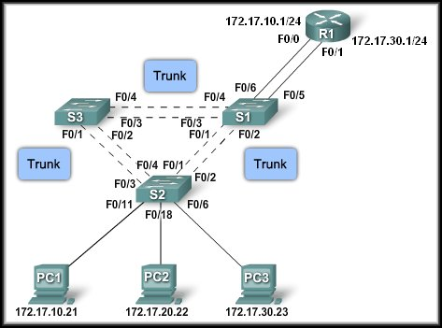
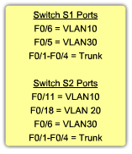

Introducing Inter-VLAN Routing
Internally Routed to the proper subnet.
Traditional Inter-VLAN Routing:
One router interface per VLAN.
Access port Assigned to VLAN10
Access port Assigned to VLAN30
Tag removed
VLAN Tagged
VLAN10
VLAN30

Slide 5
Inter-VLAN Routing Operation Router-On-A-Stick Inter-VLAN Routing
The so called router-on-a-stick approach uses a different path to route between VLANs
One of the router’s physical interfaces is configured as a 802.1Q trunk port. Now that interface can understand VLAN tags
Logical subinterfaces are then created on a single Physical Interface. One subinterface per VLAN
Each subinterface is configured with an IP address from the VLAN it represents
VLAN members (hosts) are configured to use the subinterface address as a default gateway.
Only one of the router’s physical interface is used
Notes:
5.1 Inter-VLAN Routing Configuration
5.1.1 Inter-VLAN Routing Operation
5.1.1.3 Router-On-A-Stick Inter-VLAN Routing

Slide 6
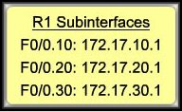
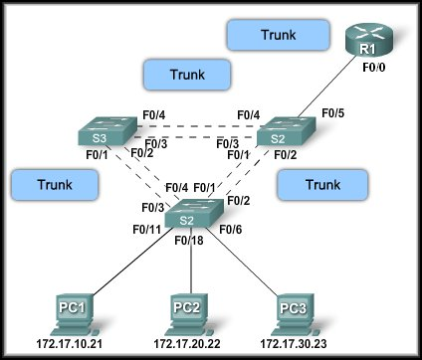
Introducing Inter-VLAN Routing
Router-on-a-stick Inter-VLAN Routing:
One router interface for all VLANs.
Internally Routed to the proper subnet.
Tag removed
VLAN Tagged

Slide 7
Inter-VLAN Routing Operation Multilayer Switch Inter-VLAN Routing
Multilayer switches can perform Layer 2 and Layer 3 functions. Routers are not required anymore
Each VLAN existent in the switch is a SVI
SVI are seen as layer 3 interfaces
The switch understands network layer PDUs and therefore, it can route between its SVIs just as a router routes between its interfaces
With a multilayer switch, traffic is routed internal to the switch device
Very scalable solution
Notes:
5.1 Inter-VLAN Routing Configuration
5.1.1 Inter-VLAN Routing Operation
5.1.1.4 Multilayer Switch Inter-VLAN Routing

Slide 8
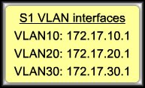
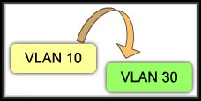
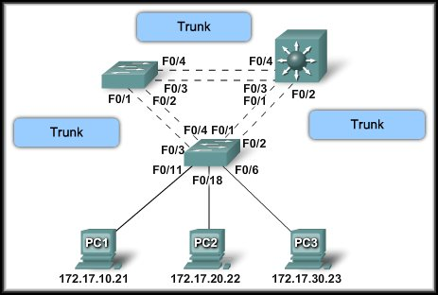
Introducing Inter-VLAN Routing
Multi Layer Switch Inter-VLAN Routing:
Some switches can perform Layer 3 functions, replacing the need for dedicated routers to perform basic routing on a network. Uses Switch Virtual Interfaces (SVI) to retag the frame.
Tag removed
VLAN Tagged
(10)

Slide 9
Configure Legacy Inter-VLAN Routing Preparation
Legacy inter-VLAN routing requires routers to have multiple physical interfaces
Each one of the router’s physical interfaces is connected to a unique VLAN
Each interface is also configured with an IP address for the subnet associated with the particular VLAN
Network devices use the router as a gateway to access the devices connected to the other VLANs
Notes:
5.1 Inter-VLAN Routing Configuration
5.1.2 Configure Legacy Inter-VLAN Routing
5.1.2.1 Configure Legacy Inter-VLAN Routing: Preparation

Slide 10
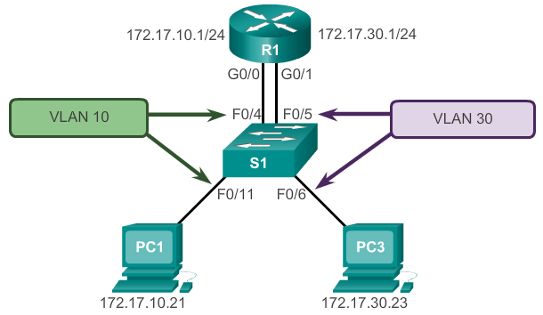
Configure Legacy Inter-VLAN Routing Preparation
D.Gate= 172.17.10.1
D.Gate= 172.17.30.1
Notes:
5.1 Inter-VLAN Routing Configuration
5.1.2 Configure Legacy Inter-VLAN Routing
5.1.2.1 Configure Legacy Inter-VLAN Routing: Preparation

Slide 11
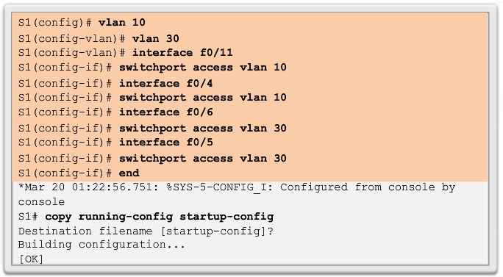
Configure Legacy Inter-VLAN Routing Switch Configuration
Notes:
5.1 Inter-VLAN Routing Configuration
5.1.2 Configure Legacy Inter-VLAN Routing
5.1.2.2 Configure Legacy Inter-VLAN Routing: Switch Configuration

Slide 12
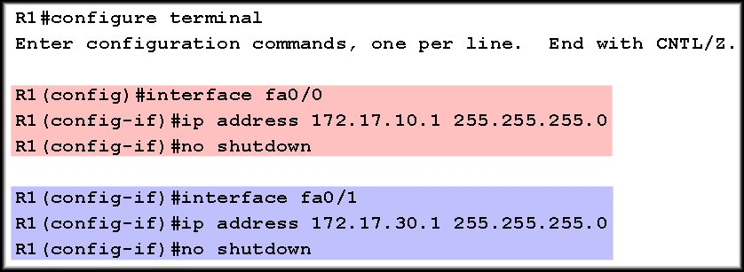
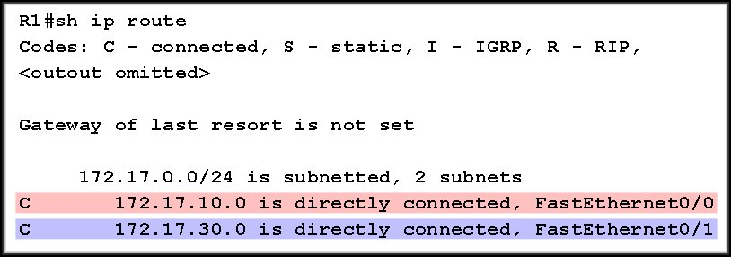
Configure Legacy Inter-VLAN Routing Router Interface Configuration
Traditional Inter-VLAN Routing

Slide 13
Configure Router-On-A-Stick Preparation
An alternative to legacy inter-VLAN routing is to use VLAN trunking and subinterfaces
VLAN trunking allows a single physical router interface to route traffic for multiple VLANs
The physical interface of the router must be connected to a trunk link on the adjacent switch
On the router, subinterfaces are created for each unique VLAN on the networ
Each subinterface is assigned an IP address specific to its subnet/VLAN and is also configured to tag frames for that VLAN
Notes:
5.1 Inter-VLAN Routing Configuration
5.1.3 Configure Router-On-A-Stick Inter-VLAN Routing
5.1.3.1 Configure Router-On-A-Stick: Preparation

Slide 14
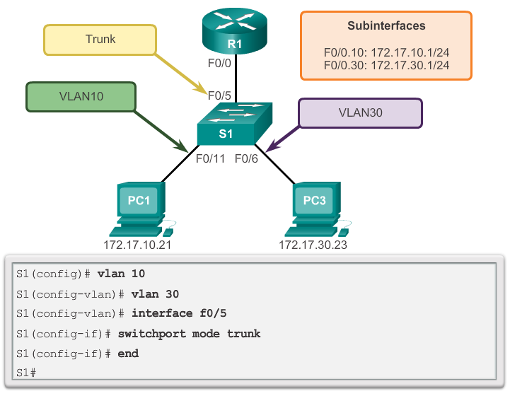
Configure Router-On-A-Stick Switch Configuration
Notes:
5.1 Inter-VLAN Routing Configuration
5.1.3 Configure Router-On-A-Stick Inter-VLAN Routing
5.1.3.2 Configure Router-On-A-Stick: Switch Configuration

Slide 15
Router-on-a-stick Inter-VLAN Router config
1) Create the subinterface:
The syntax for the subinterface is always the physical interface, followed by a period and a subinterface number.
The subinterface number is configurable, but it is typically associated to reflect the VLAN number.
R1(config)#interface fa0/0.10
2) Assign it to a VLAN:
Before assigning an IP Address, the interface must to be configured to operate on a specific VLAN using the proper encapsulation.
R1(config-subif)#encapsulation dot1q vlan-id
3) Assign an IP Address:
The IP Address assigned here will become the default gateway for that VLAN.
R1(config-subif)#ip address [address] [mask]
4) Enable the interface:
Subinterfaces are not enabled individually. When the physical interface is enabled, all associated subinterfaces are enabled.
R1(config-if)#no shutdown

Slide 16
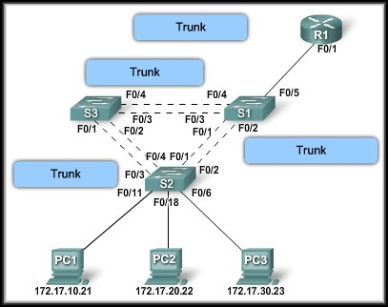
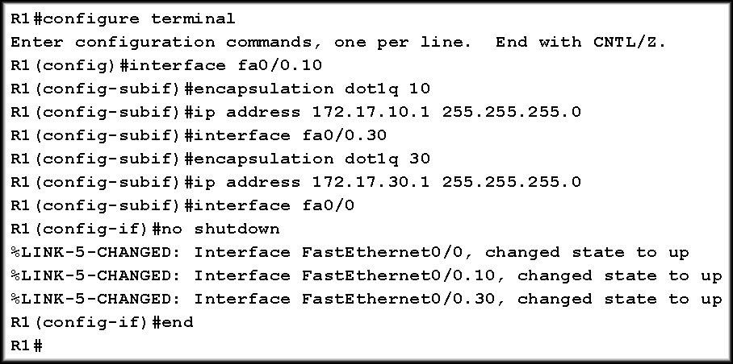
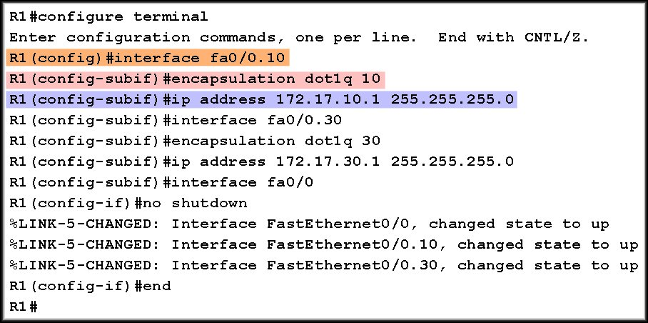
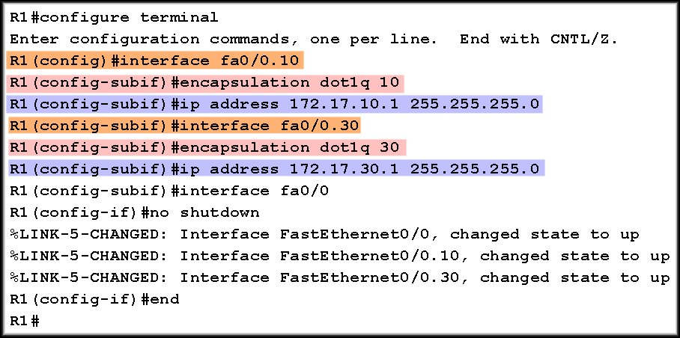
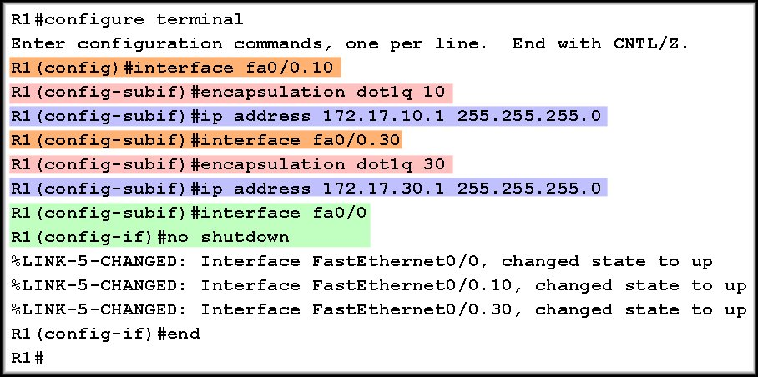
Configuring Subinterfaces
VLAN 10
VLAN 10
VLAN 10
VLAN 30
VLAN 30
Enable Interfaces

Slide 17
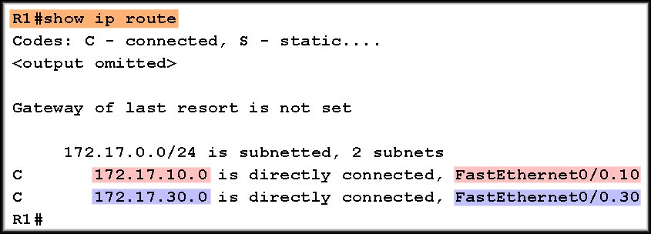
Interfaces and Subinterfaces
Planning!

Slide 18
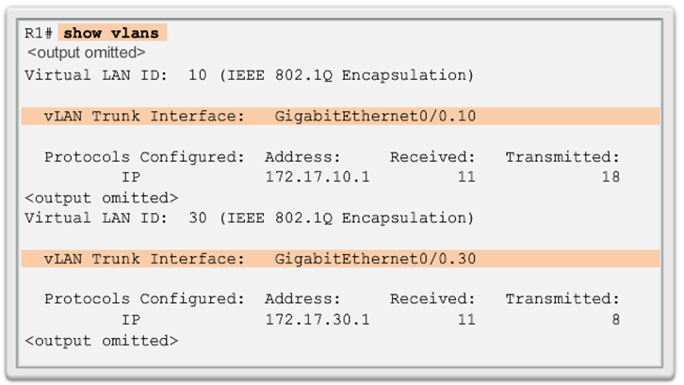
Configure Router-On-A-Stick Verifying Subinterfaces
Notes:
5.1 Inter-VLAN Routing Configuration
5.1.3 Configure Router-On-A-Stick Inter-VLAN Routing
5.1.3.4 Configure Router-On-A-Stick: Verifying Subinterfaces

Slide 19
Subinterface advantages / disadvantage
Port Limits
Physical interfaces are configured to have one interface per VLAN. On networks with many VLANs, using a single router to perform inter-VLAN routing is not possible.
Subinterfaces allow a router to scale to accommodate more VLANs .
Performance
Because there is no contention for bandwidth on physical interfaces, physical interfaces have better performance for inter-VLAN routing.
When subinterfaces are used for inter-VLAN routing, the traffic being routed competes for bandwidth on the single physical interface. On a busy network, this could cause a bottleneck for communication.
Access Ports and Trunk Ports
Connecting physical interfaces for inter-VLAN routing requires that the switch ports be configured as access ports. Subinterfaces require the switch port to be configured as a trunk port so that it can accept VLAN tagged traffic on the trunk link.
Cost
Routers that have many physical interfaces cost more than routers with a single interface. Additionally, if you have a router with many physical interfaces, each interface is connected to a separate switch port, consuming extra switch ports on the network.
Financially, it is more cost-effective to use subinterfaces over separate physical interfaces.
Notes:
Use graphic 1.1.1.1
Use graphic 1.1.1.3

Slide 20
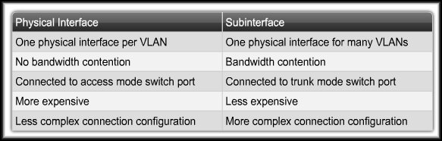
Subinterface advantages and disadvantage
Complexity
Using subinterfaces for inter-VLAN routing results in a less complex physical configuration (less cables) than using separate physical interfaces.
On the other hand, using subinterfaces with a trunk port results in a more complex software configuration, which can be difficult to troubleshoot.
If one VLAN is having trouble routing to other VLANs, you cannot simply trace the cable to see if the cable is plugged into the correct port.
You need to check to see if the switch port is configured to be a trunk and verify that the VLAN is not being filtered on any of the trunk links before it reaches the router interface.
You also need to check that the router subinterface is configured to use the correct VLAN ID and IP address for the subnet associated with that VLAN.
Notes:
Use graphic 1.1.1.1
Use graphic 1.1.1.3

Slide 21
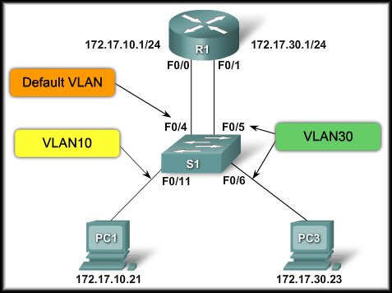
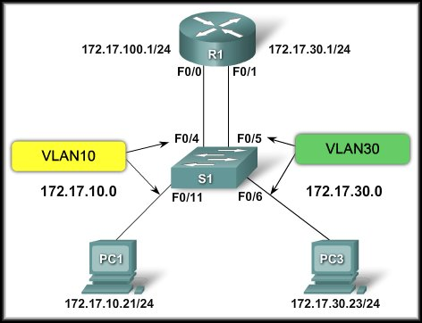
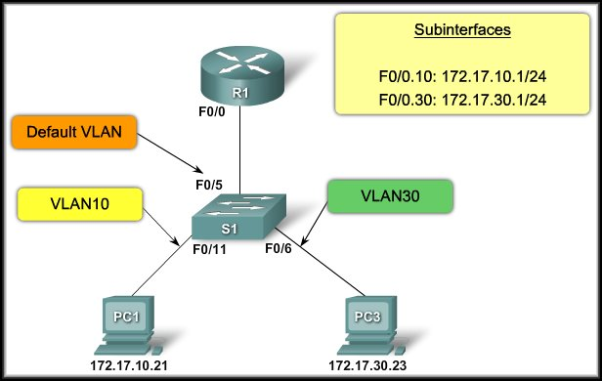
Inter-VLAN Routing
Troubleshooting Inter-VLAN Routing

Slide 22
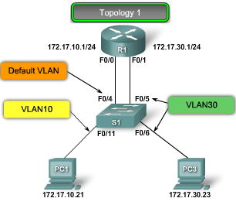
Switch Configuration Issues: 1
When using the traditional routing model for inter-VLAN routing, ensure that the switch ports that connect to the router interfaces are configured on the correct VLANs.
If the switch ports are not configured on the correct VLAN, devices configured on that VLAN cannot connect to the router interface, and therefore, are unable to route to the other VLANs.
As you can see in Topology 1, PC1 and router R1 interface F0/0 are configured to be on the same logical subnet, as indicated by their IP address assignment.
However, the switch port F0/4 that connects to router R1 interface F0/0 has not been configured and remains in the default VLAN.
Because router R1 is on a different VLAN than PC1, they are unable to communicate.
To correct this problem, execute the switchport access vlan 10 interface configuration command on switch port F0/4 on switch S1.
Notes:
Use graphic 1.1.1.1
Use graphic 1.1.1.3

Slide 23
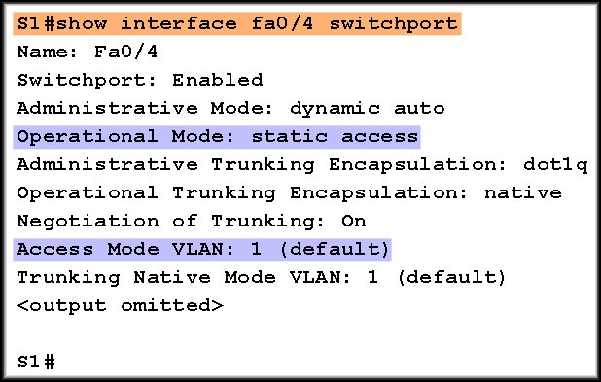
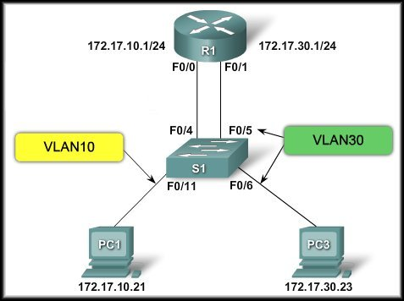
Switch Configuration Issue 1
VLAN 30 is working but VLAN 10 cannot communicate with the router or VLAN 30.
Interface F0/4 is still in the default VLAN.
switchport access vlan 10

Slide 24
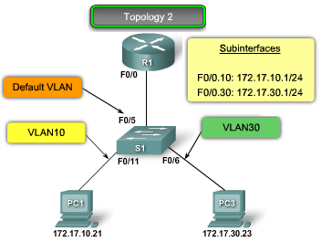
Switch Configuration Issues: 2
In Topology 2, the router-on-a-stick routing model has been chosen. However, the F0/5 interface on switch S1 is not configured as a trunk and subsequently left in the default VLAN for the port.
As a result, the router is not able to function correctly because each of its configured subinterfaces is unable to send or receive VLAN tagged traffic.
This prevents all configured VLANs from routing through router R1 to reach the other VLANs.
To correct this problem, execute the switchport mode trunk interface configuration command on switch port F0/5 on switch S1.
This converts the interface to a trunk, allowing the trunk to successfully establish a connection with router R1.
Notes:
Use graphic 1.1.1.1
Use graphic 1.1.1.3

Slide 25
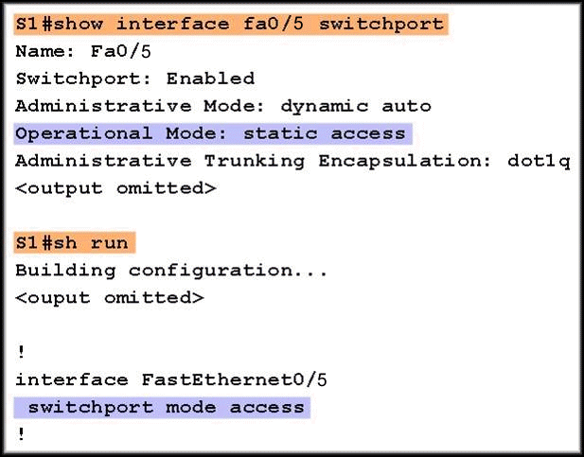
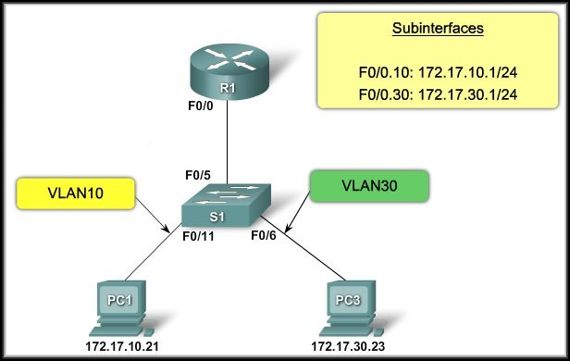
Switch Configuration Issues: 2
Each of the configured subinterfaces is unable to send or receive VLAN traffic.
Interface F0/5 is still in the default VLAN.
switchport mode trunk

Slide 26
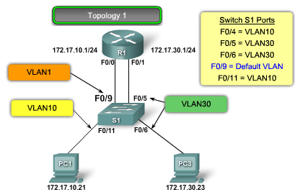
Router Configuration Issues: 3
One of the most common inter-VLAN router configuration errors is to connect the physical router interface to the wrong switch port,
placing it on the incorrect VLAN and preventing it from reaching the other VLANs.
As you can see in Topology 3, router R1 interface F0/0 is connected to switch S1 port F0/9. Switch port F0/9 is configured for Default VLAN, not VLAN10.
This prevents PC1 from being able to communicate with the router interface, and it is therefore unable to route to VLAN30.
To correct this problem, physically connect router R1 interface F0/0 to switch S1 port F0/4.
This puts the router interface on the correct VLAN and allows inter-VLAN routing to function.
Alternatively, you could change the VLAN assignment of switch port F0/9 to be on VLAN10. This also allows PC1 to communicate with router R1 interface F0/0.
Notes:
Use graphic 1.1.1.1
Use graphic 1.1.1.3

Slide 27
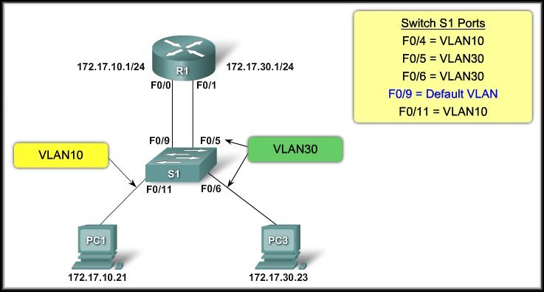

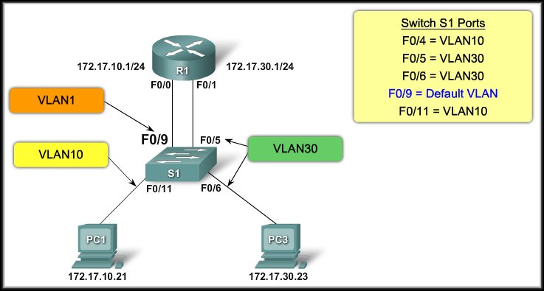
Router Configuration Issues: 3
PC1 cannot communicate with the router interface and the router cannot route to VLAN 30.
Switch port F0/4 is for VLAN 10.
Switch port F0/9 is assigned to the default VLAN.
Move the cable from F0/9 to F0/4.
Move the cable from F0/9 to F0/4.
One of the most common mistakes in Inter-VLAN routing.

Slide 28
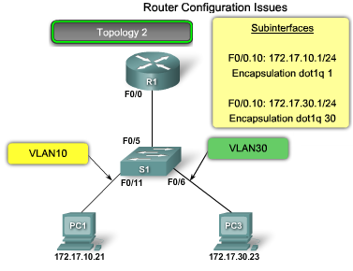
Router Configuration Issues: 4
In Topology 4, router R1 has been configured to use the wrong VLAN on subinterface F0/0.10,
preventing devices configured on VLAN10 from communicating with subinterface F0/0.10.
To correct this problem, configure subinterface F0/0.10 to be on the correct VLAN using the encapsulation dot1q 10 subinterface configuration mode command.
When the subinterface has been assigned to the correct VLAN, it is accessible by devices on that VLAN and can perform inter-VLAN routing.
Notes:
Use graphic 1.1.1.1
Use graphic 1.1.1.3

Slide 29
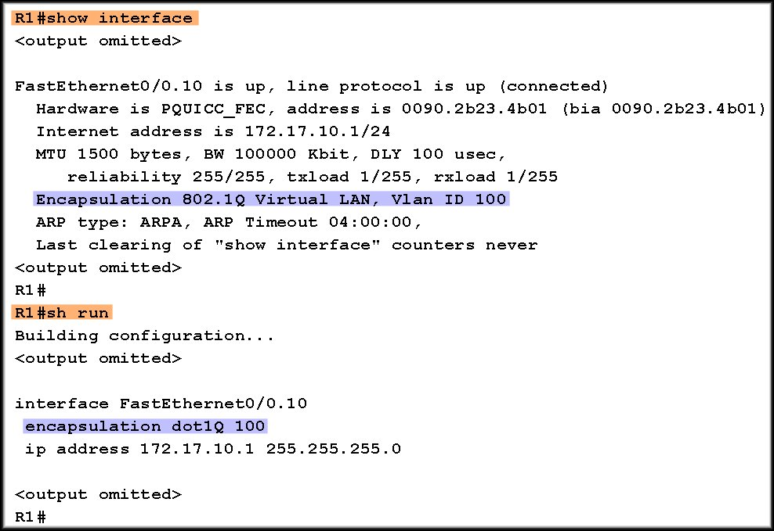
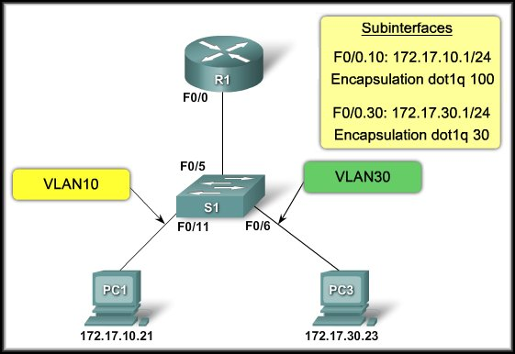

Router Configuration Issues: 4
PC1 cannot communicate with the router interface and the router cannot route to VLAN 30.

Slide 30
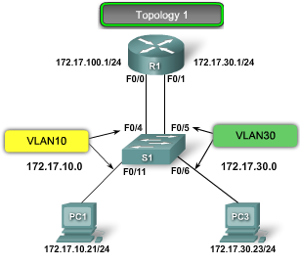
IP Addressing Issues: 5
For inter-VLAN routing to operate, each interface, or subinterface, needs to be assigned an IP address that corresponds to the subnet for which it is connected.
As you can see in Topology 5, router R1 has been configured with an incorrect IP address on interface F0/0.
To correct this problem, assign the correct IP address to router R1 interface F0/0 using the ip address 172.17.10.1 255.255.255.0 interface command in configuration mode.
After the router interface has been assigned the correct IP address, PC1 can use the interface as a default gateway for accessing other VLANs.
Notes:
Use graphic 1.1.1.1
Use graphic 1.1.1.3

Slide 31
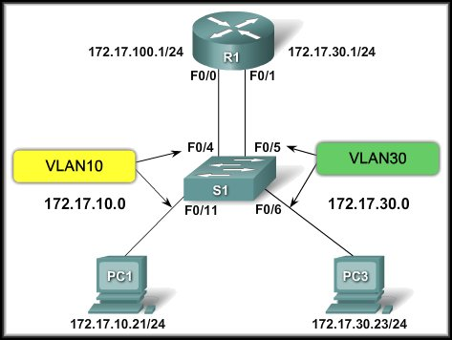


IP Addressing Issues: 5
PC1 cannot communicate.
Incorrect IP address for subnet 172.16.10.0/24.
Incorrect IP address for subnet 172.16.10.0/24.
Incorrect subnet mask for subnet 172.16.10.0/24.

Slide 32
Configure Router-On-A-Stick Verifying Routing
Access to devices on remote VLANs can be tested using the ping command.
The pingcommand sends an ICMP echo request to the destination address
When a host receives an ICMP echo request, it responds with an ICMP echo reply
Tracert is a useful utility for confirming the routed path taken between two devices
Notes:
5.1 Inter-VLAN Routing Configuration
5.1.3 Configure Router-On-A-Stick Inter-VLAN Routing
5.1.3.5 Configure Router-On-A-Stick: Verifying Routing

Slide 33
Layer 3 Switching Operation And Configuration Introduction To Layer 3 Switching
Layer 3 switches usually have packet-switching throughputs in the millions of packets per second (pps)
All Catalyst switches support two types of Layer 3 interfaces:
Routed Port
SVI
High-performance switches, such as the Catalyst 6500 and Catalyst 4500, are able to perform most of the router’s functions
But several models of Catalyst switches require enhanced software for specific routing protocol feature.
L3 Switches can “Route” faster than Routers
Notes:
5.3 Layer 3 switching
5.3.1 Layer 3 Switching Operation And Configuration
5.3.1.1 Introduction To Layer 3 Switching

Slide 34
Layer 3 Switching Operation And Configuration Inter-VLAN Routing with SVIs
Today routing has become faster and cheaper and can performed at hardware speed
It can be transferred to core and distribution devices with little to no impact on network performance
Many users are in separate VLANs, and each VLAN is usually a separate subnet
This implies that each distribution switch must have IP addresses matching each access switch VLAN
Layer 3 (routed) ports are normally implemented between the distribution and the core layer
This model is less dependent on spanning-tree as there are no loops in the Layer 2 portion of the topology
Notes:
5.3 Layer 3 switching
5.3.1 Layer 3 Switching Operation And Configuration
5.3.1.2 Inter-VLAN Routing with Switch Virtual Interfaces

Slide 35
Layer 3 Switching Operation And Configuration Inter-VLAN Routing with SVIs (cont)
By default, an SVI is created for the default VLAN (VLAN1). This allows for remote switch administration
Any additional SVIs must be created by the admin
SVIs are created the first time the VLAN interface configuration mode is entered for a particular VLAN SVI
The interface vlan 10 entered by the first time creates an SVI named VLAN 10
The VLAN number used corresponds to the VLAN tag associated with data frames on an 802.1Q encapsulated trunk
Whenever the SVI is created, ensure that particular VLAN is present in the VLAN database
Notes:
5.3 Layer 3 switching
5.3.1 Layer 3 Switching Operation And Configuration
5.3.1.3 Inter-VLAN Routing with Switch Virtual Interfaces (cont)

Slide 36
Layer 3 Switching Operation And Configuration Inter-VLAN Routing with SVIs (cont)
SVIs advantages include:
It is much faster than router-on-a-stick, because everything is hardware switched and routed.
No need for external links from the switch to the router for routing.
Not limited to one link. Layer 2 Ether Channels can be used between the switches to get more bandwidth.
Latency is much lower, because it does not need to leave the switch.
Notes:
5.3 Layer 3 switching
5.3.1 Layer 3 Switching Operation And Configuration
5.3.1.3 Inter-VLAN Routing with Switch Virtual Interfaces (cont)

Slide 37
Layer 3 Switching Operation And Configuration Inter-VLAN Routing with Routed Ports
A routed port is a physical port that acts similarly to an interface on a router
Routed ports are not associated with any VLANs
Layer 2 protocols, such as STP, do not function on a routed interface
Routed ports on a Cisco IOS switch do not support subinterfaces
To configure routed ports, use the no switchport interface configuration mode command
Note: Routed ports are not supported on Catalyst 2960 Series switches.
Notes:
5.3 Layer 3 switching
5.3.1 Layer 3 Switching Operation And Configuration
5.3.1.4 Inter-VLAN Routing with with Routed Ports

Slide 38
Layer 3 Switching Operation And Configuration Configuring Static Routes on a Cat2960
The Cisco Switch Database Manager (SDM) provides multiple templates for the 2960 switch
The sdm lanbase-routing template can be enabled to allow the switch to route between VLANs and to support static routing
Use the show sdm prefer command verify which template is in use
The SDM template can be changed in global configuration mode with the sdm prefer command
Notes:
5.3 Layer 3 switching
5.3.1 Layer 3 Switching Operation And Configuration
5.3.1.5 Configuring Static Routes on a Catalyst 2960

Slide 39
Troubleshooting Layer 3 Switching Layer 3 Switching Configuration Issues
To troubleshoot Layer 3 switching issues, check the following items for accuracy:
VLANs
VLANs must be defined across all the switches
VLANs must be enabled on the trunk ports
Ports must be in the right VLANs
SVIs
SVI must have the correct IP address or subnet mask
SVI must be up
SVI must match with the VLAN number
Notes:
5.3 Layer 3 switching
5.3.2 Troubleshooting Layer 3 Switching
5.3.2.1 Layer 3 Switching Configuration Issues

Slide 40
Troubleshooting Layer 3 Switching Layer 3 Switching Configuration Issues
To troubleshoot Layer 3 switching issues, check the following items for accuracy (cont):
Routing
Routing must be enabled
Each interface or network should be added to the routing protocol
Hosts
Hosts must have the correct IP address or subnet mask
Hosts must have a default gateway associated with an SVI or routed port
Notes:
5.3 Layer 3 switching
5.3.2 Troubleshooting Layer 3 Switching
5.3.2.1 Layer 3 Switching Configuration Issues

Slide 41


